Slide 1

Week 2 – IT for Business – Sydney Campus
Summary of Lecture 1
Tutorial Week 2
Attendance & Multiple-choice Questions - Recognising student participation and engagement specifically identifying those who are most actively involved!
Key assessment dates
Referencing & Citations
Preparation for Discussion Activity 1
Lecturer/Tutor: Dr. Farshid Keivanian

Slide 2
1. Summary of Lecture 1
The lecture content on "IT for Business" emphasizes the integral role of Information Technology (IT) in modern businesses, showcasing its impact across various sectors with a focus on practical examples from Australia. It delves into how businesses utilize IT for customer engagement, operational efficiency, decision-making, and information management, underscoring the necessity for business professionals to adeptly navigate IT development and application.

Slide 3
1. Summary of Lecture 1
A notable highlight is the use of social media platforms like Facebook, Twitter, and Instagram by businesses for engaging with customers, showcasing products, and conducting targeted advertising campaigns. Similarly, mobile banking exemplifies the financial industry's reliance on IT, offering services like account management and electronic check deposits via mobile apps, enhancing customer convenience and operational efficiency.

Slide 4
1. Summary of Lecture 1
The lecture further explores the significance of the binary counting system and digital systems in Australia, citing the National Broadband Network (NBN) and healthcare sector's digitalization as key examples. It also covers the use of electromagnetic signals in telecommunications and medical imaging, and the application of information systems in inventory and traffic management, healthcare records, financial analysis, and customer relationship management (CRM).

Slide 5
1. Summary of Lecture 1
Practical examples in Australia include the Sydney public transportation system as a model of efficient system operation, the healthcare system's use of digital patient records for better care, and the role of CRM systems in improving customer service and marketing strategies. Additionally, the lecture discusses the career opportunities in the IT sector in Australia, highlighting roles like software development, cybersecurity, data analysis, and network administration, indicating the high demand for IT professionals in the country.

Slide 6
1. Summary of Lecture 1
In summary, the lecture presents a comprehensive overview of how IT underpins critical aspects of business operations and strategy, with practical examples demonstrating its application across various sectors in Australia. It underscores the importance of IT proficiency for business professionals and the dynamic nature of career opportunities in the IT industry.

Slide 7
2. Tutorial Week 2
Question 2.1. There are many types of business roles in an organisation that are integral to
company operations. From executive-level professionals to entry-level employees, these roles
involve specific tasks that contribute to a company's success. We have discussed these roles
from different aspects. What would you expect your involvement to be as a business
professional for information systems projects and initiatives?

Slide 8
2. Tutorial Week 2
2.1: Involvement as a Business Professional in Information Systems Projects
As a business professional in Australia, my involvement in information systems projects and initiatives would likely include defining business requirements, ensuring the alignment of the project with strategic goals, and managing stakeholder expectations. For example, a project manager at an Australian retail company such as Woolworths may work closely with IT teams to develop an e-commerce platform that meets consumer demands and aligns with the company's digital transformation strategy.

Slide 9
2. Tutorial Week 2
Question 2.2. Information systems are expected to resolve business problems. However,
information systems cannot solve some business problems. Give three examples and explain
why technology cannot help

Slide 10
2.2: Business Problems Information Systems Cannot Solve
Low Employee Morale: Technology can improve communication or provide analytics, but it cannot directly address issues like poor leadership, lack of recognition, or workplace culture problems. For instance, despite the use of advanced HR software, a company like Telstra cannot solve low employee morale without addressing the root causes such as management practices or work-life balance.
Ethical Issues: Information systems cannot resolve ethical dilemmas, such as decisions involving layoffs or product sourcing. For example, a decision by BHP to source materials from less ethical suppliers cannot be resolved by information systems but requires ethical leadership and corporate responsibility.
Customer Trust and Loyalty: While CRM systems can manage customer relationships to a certain extent, they cannot alone build trust or loyalty. This is exemplified by the Australian airline Qantas, which relies on personalized service and quality experiences, beyond what any information system can provide, to maintain customer loyalty.

Slide 11
2. Tutorial Week 2
Question 2.3. Knowledge workers are workers whose main capital is knowledge. Practically
all knowledge workers must know how to use information systems. Why?

Slide 12
2.3: Knowledge Workers and Information Systems
Knowledge workers, such as data analysts, researchers, and professional services providers in Australia, must use information systems because these tools enable them to access, analyze, and share vast amounts of information efficiently. For example, a financial analyst at Commonwealth Bank of Australia relies on information systems for real-time market data analysis to make investment decisions.

Slide 13
2. Tutorial Week 2
Question 2.4. It is highly likely that we will soon stop talking of e-commerce and simply speak
of commerce. Why?

Slide 14
2.4: E-commerce Becoming Simply "Commerce"
The distinction between e-commerce and traditional commerce is increasingly blurring due to the pervasive integration of digital technologies in all aspects of buying and selling. In Australia, retailers like JB Hi-Fi have integrated online and offline shopping experiences so seamlessly that the consumer journey may involve both digital and physical interactions, making "commerce" a more holistic term that naturally includes electronic transactions.

Slide 15
2. Tutorial Week 2
Question 2.5. Help wanted advertisements do not use the term "computer specialists"; rather,
they use the term "information system professionals" or "information technology
professionals." Why?

Slide 16
2.5: "Information System Professionals" vs. "Computer Specialists"
Job advertisements prefer "information system professionals" or "information technology professionals" over "computer specialists" because these roles encompass a broader range of responsibilities beyond just computer operations. They involve understanding how technology can support business objectives, analyzing data, and managing systems that improve efficiency and innovation. For example, a role advertised by ANZ Bank for an Information Technology Professional would likely involve strategic planning and management of technology to support banking operations, rather than merely fixing computers.

Slide 17
2. Tutorial Week 2
Question 2.6. Information technology might bring people together, but it also isolates them.
Explain the latter claim and give an example. How does social media help or harm
interrelationships between business professionals? Business organisations?

Slide 18
2.6 Technology's Isolating Effects
While information technology connects people, it can also isolate them by reducing face-to-face interaction and deepening reliance on digital communication. For example, remote working tools like Zoom have enabled business professionals to connect from anywhere, yet they can lead to a sense of isolation and lack of personal connection. Social media platforms can both help and harm business relationships; they facilitate networking and brand promotion but can also lead to miscommunications or a focus on quantity over quality of connections.

Slide 19
2. Tutorial Week 2
Question 2.7. Give two examples of phenomena that are a social concern because of
information technology. Explain.

Slide 20
2.7 Social Concerns Due to Information Technology
Privacy Invasion: The collection and analysis of personal data by companies like Facebook have raised concerns over privacy and data security in Australia, leading to calls for stronger data protection laws.
Cyberbullying: The rise of social media has led to an increase in cyberbullying, affecting individuals and workplaces, necessitating policies and interventions to combat online harassment.

Slide 21
2. Tutorial Week 2
Question 2.8. What irritates you about the web? What would you do to minimise this irritation?

Slide 22
2.8: Irritations About the Web and Solutions
One irritation about the web is the overwhelming presence of intrusive ads and pop-ups. To minimize this, I would use ad blockers and support websites that offer ad-free experiences through subscriptions. Another irritation is the misinformation spread on social media; promoting digital literacy and critical thinking skills would help users evaluate information more effectively.

Slide 23
2. Tutorial Week 2
Question 2.9. Identity theft existed before the advent of the Internet. However, increased
identity theft is one of the unintended, undesirable results of using the Internet. What is the
role of educating the public in containing this crime?

Slide 24
2.9: Role of Public Education in Containing Identity Theft
Educating the public plays a crucial role in containing identity theft by raising awareness about safe online practices, such as using strong, unique passwords and being cautious about sharing personal information. Public education initiatives can include government campaigns, resources provided by financial institutions like Westpac, and educational programs in schools to teach Australians how to protect themselves online.

Slide 25
3. Attendance & Multiple-choice Questions - Recognising student participation and engagement specifically identifying those who are most actively involved!
Question 1: Which of the following best describes the role of Information Technology (IT) in businesses, as discussed in the lecture?
A) Solely for automating manual processes.
B) Primarily for financial management only.
C) Enhancing customer engagement and operational efficiency.
D) Used only in the IT sector.
Question 2: According to the lecture, why can’t information systems alone solve low employee morale?
A) Because technology cannot replace human interactions.
B) Technology can automatically improve morale without any human intervention.
C) IT systems are not designed to address human resource functions.
D) Employee morale is not affected by IT systems.
Question 3: What is the significance of referring to job roles as "information system professionals" instead of "computer specialists"?
A) It emphasizes the technical nature of the job, focusing solely on computer repair.
B) It highlights a broader range of responsibilities beyond just managing computers, including strategic technology management.
C) It suggests that these professionals do not work with modern technology.
D) It indicates a role focused exclusively on coding and software development.

Slide 26
3. Attendance & Multiple-choice Questions - Recognising student participation and engagement specifically identifying those who are most actively involved!
Question 1: Which of the following best describes the role of Information Technology (IT) in businesses, as discussed in the lecture?
A) Solely for automating manual processes.
B) Primarily for financial management only.
C) Enhancing customer engagement and operational efficiency.
D) Used only in the IT sector.
Question 2: According to the lecture, why can’t information systems alone solve low employee morale?
A) Because technology cannot replace human interactions.
B) Technology can automatically improve morale without any human intervention.
C) IT systems are not designed to address human resource functions.
D) Employee morale is not affected by IT systems.
Question 3: What is the significance of referring to job roles as "information system professionals" instead of "computer specialists"?
A) It emphasizes the technical nature of the job, focusing solely on computer repair.
B) It highlights a broader range of responsibilities beyond just managing computers, including strategic technology management.
C) It suggests that these professionals do not work with modern technology.
D) It indicates a role focused exclusively on coding and software development.

Slide 27
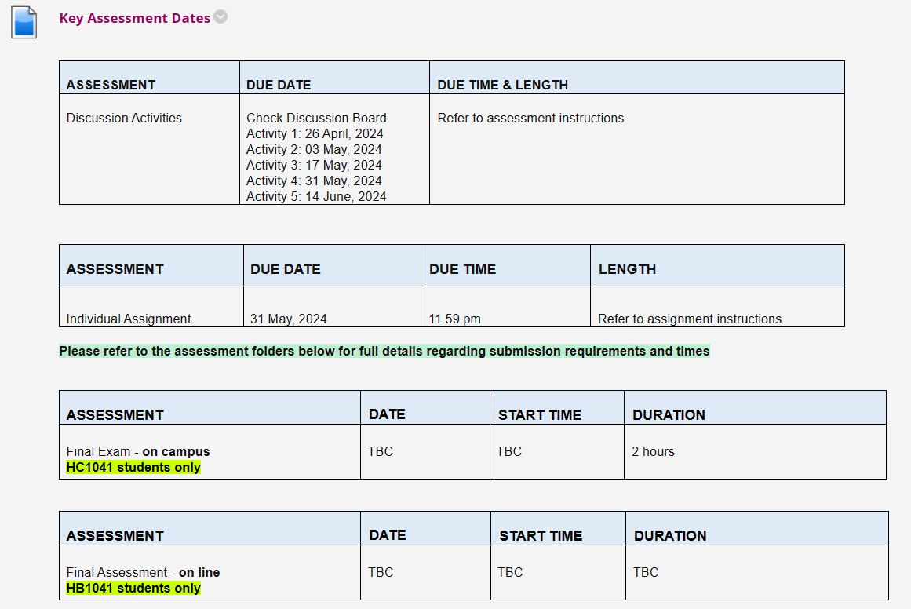
4. Key assessment dates

Slide 28

5. Referencing & Citations

Slide 29

5. Referencing & Citations

Slide 30
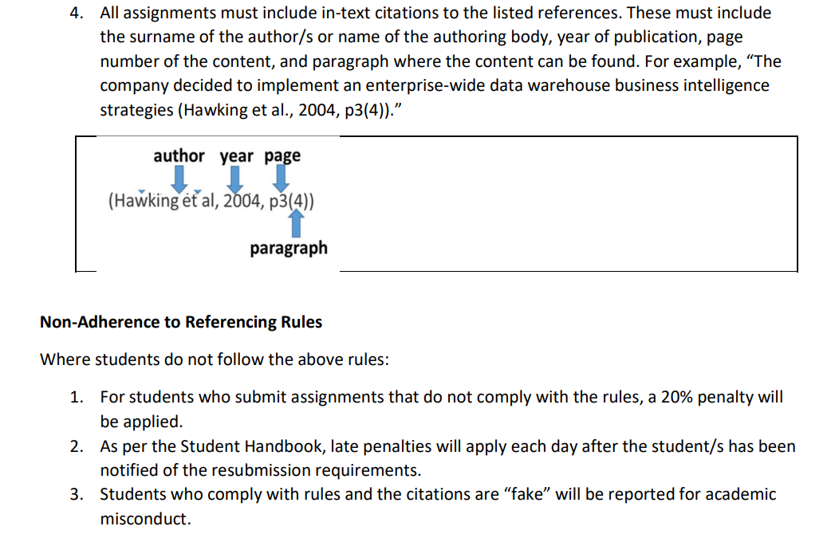
5. Referencing & Citations

Slide 31

* Additional Resources (Share files)

Slide 32
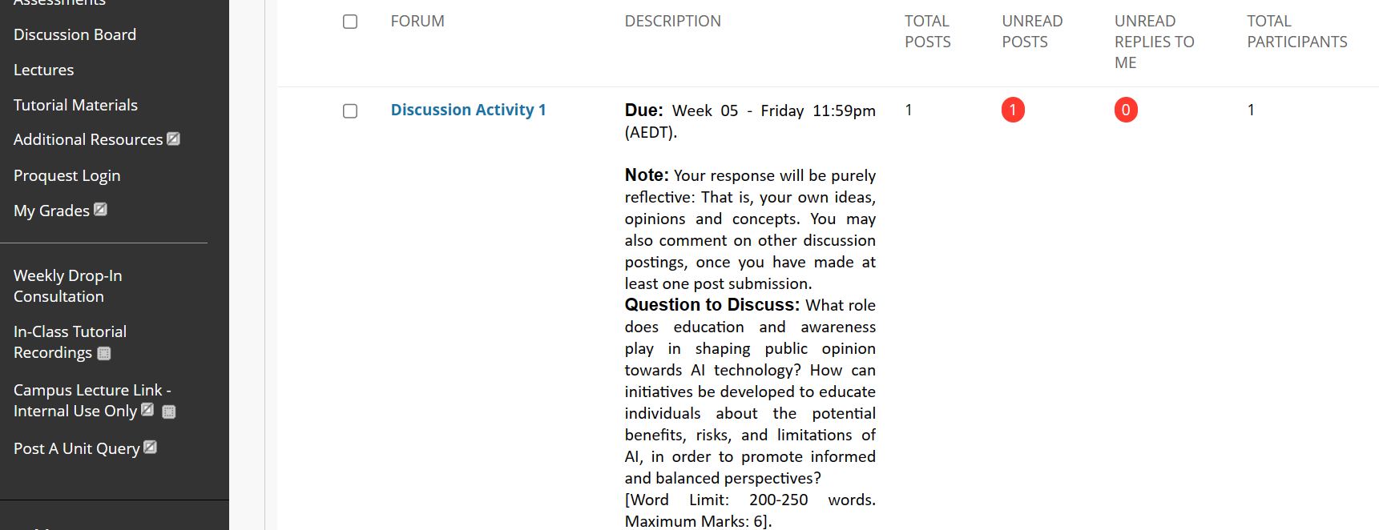
6. Preparation for Discussion Activity 1

Slide 33
6. Preparation for Discussion Activity 1
Discussion Activity 1
Educating the public plays a crucial role in containing identity theft by raising awareness about safe online practices, such as using strong, unique passwords and being cautious about sharing personal information. Public education initiatives can include government campaigns, resources provided by financial institutions like Westpac, and educational programs in schools to teach Australians how to protect themselves online.

Slide 34
6. Preparation for Discussion Activity 1
Education and awareness are pivotal in shaping public opinion towards AI technology, serving as the bridge between misconceptions and informed perspectives. The rapid evolution of AI has outpaced the general public's understanding, often leading to polarized views characterized by unrealistic fears or overly optimistic expectations. Through targeted education and awareness campaigns, individuals can gain a nuanced understanding of AI, recognizing its potential benefits in healthcare, business, and daily life, while also being cognizant of its ethical, privacy, and employment implications.

Slide 35
6. Preparation for Discussion Activity 1
Developing initiatives to educate about AI involves a multifaceted approach. Firstly, integrating AI education into school curriculums can demystify the technology for younger generations, fostering an early understanding of its workings and implications. Public workshops, webinars, and open courses can cater to a wider audience, breaking down complex AI concepts into digestible information accessible to all. Collaboration between governments, educational institutions, and tech companies can facilitate the creation of resources and platforms that offer accurate information and encourage critical thinking about AI's role in society.

Slide 36
6. Preparation for Discussion Activity 1
Moreover, creating platforms for dialogue and debate around AI can encourage public engagement, allowing people to voice concerns, ask questions, and learn from experts. Such discussions can illuminate the ethical dimensions of AI, promoting a more balanced and informed public discourse.
In sum, education and awareness are instrumental in equipping the public with the knowledge to navigate the complexities of AI, ultimately fostering a society that can harness the technology responsibly and ethically.

